Slide 1
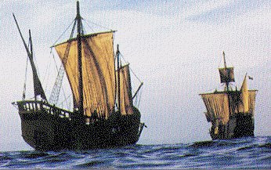
EXPLORATION
Reasons for Exploration

Slide 2
Let’s Review
Why did European's explore by sea?
Who were the two main players in exploration?
What are the Three “G’s”?

Slide 3
Let’s Explore
“Exploration”
some more!

Slide 4




Columbian Exchange
describes the enormous exchange of plants, animals, foods, human populations (including slaves), diseases, and ideas between the Eastern and Western hemispheres that occurred after 1492.

Slide 5
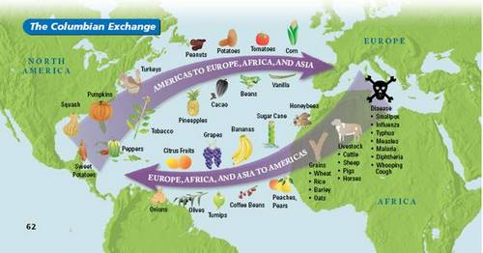
Columbian Exchange

Slide 6
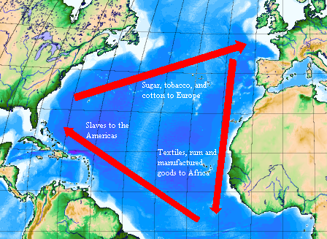
Triangular Trade

Slide 7
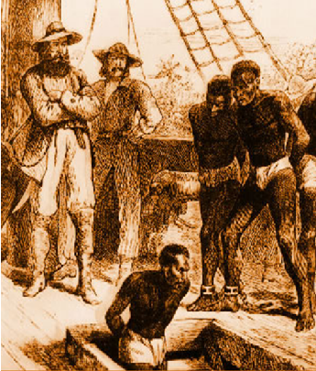
Middle Passage
the forced transportation of African people from Africa to the New World as part of the Atlantic slave trade
the middle portion of the triangular trade voyage.

Slide 8
Let’s watch a video

Slide 9


Slide 10
Major
Developments
of Colonial
Expansion

Slide 11
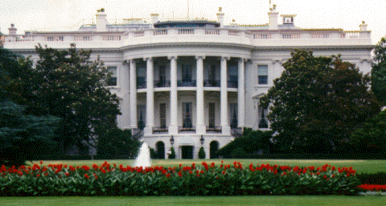
1. Political Developments
New forms of GOVERNMENT in colonial areas.

Slide 12
In your own words,
describe the term
POLITICAL and
use an example.

Slide 13

SOCIAL DEVELOPMENTS
PEOPLE & RELIGION
Christianity Spreads to new lands
Population grew in America

Slide 14
Describe a
specific social
development.

Slide 15
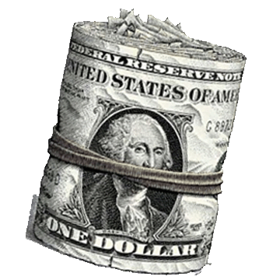
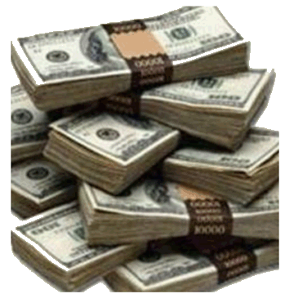
ECONOMIC DEVELOPMENTS
MONEY
Trade Routes shifts from Mediterranean Sea to the Atlantic Ocean.
Capitalism and Mercantilism are used to promote trade.
Increased IMPORTS

Slide 16
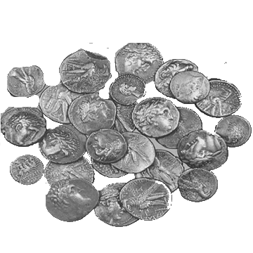
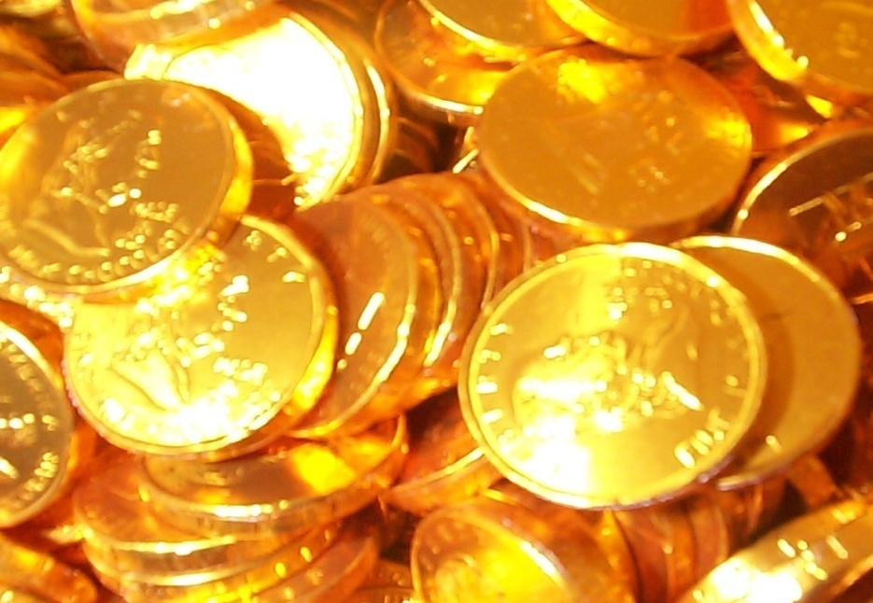
MERCANTILISM
The belief that the wealth of a nation is based on its supply of GOLD and SILVER.

Slide 17
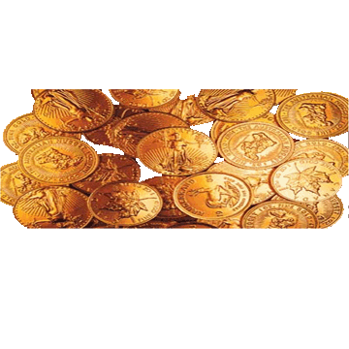
Mercantilism
theory of trade
fixed amount of gold
export more than it imports
accumulate bullion (gold)

Slide 18
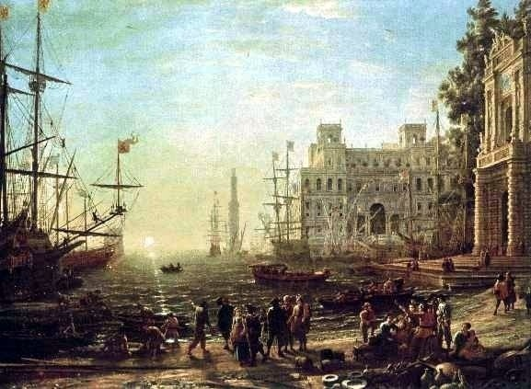
Mercantilism
There is a fixed amount of wealth in the world and that in order to receive a larger share, one country has to take some wealth away from another country.

Slide 19

What role did mercantilism play with the colonies?
European powers aimed to colonize overseas lands that were rich in gold, silver, and raw materials that could not be produced at home.
A powerful nation sought to buy raw materials from its own colonies.

Slide 20
Mercantilism was a major factor in which of the following?
  Signing military alliances for mutual protection.
  Establishing monarchies in Europe.
  Creating colonial empires.
  Generating new constitutions for developing countries.

Slide 21
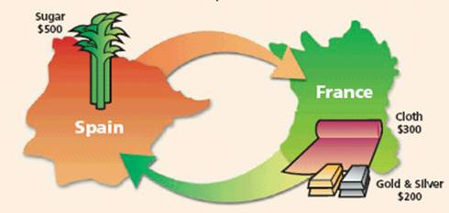
What does this picture mean?

Slide 22
One of the main reasons why European nations colonized new areas was because they believed in mercantilism. This system was based on the idea that a nation made money by exporting more goods than it imported. European nations did whatever they could to secure that.

Slide 23
CAPITALISM
Private ownership of a business. The goal is to make PROFIT!

Slide 24

Capitalism
Production for a profit!

Slide 25
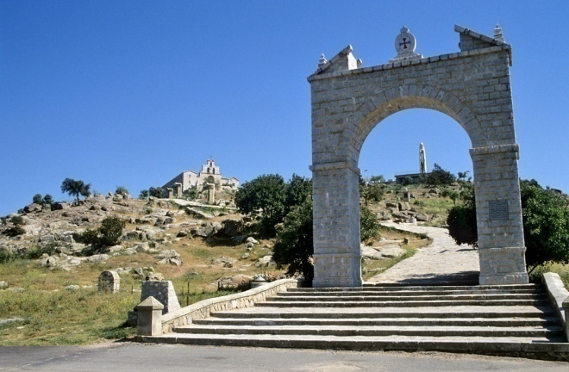
Powerful nations like Britain, France, and Spain realized that they could increase their exports and revenue by colonizing new areas. The colonized nations were forced to import the goods
of the Mother Country, and the
colonists were heavily taxed.

Slide 26

This system had positive and negative outcomes.
Divide into two groups.
  One group consider the advantages of colonialism.
  The other should consider its disadvantages.
Each group should write
down three legitimate
points.
For example: Colonists can be taxed, thus providing new revenue.

Slide 27


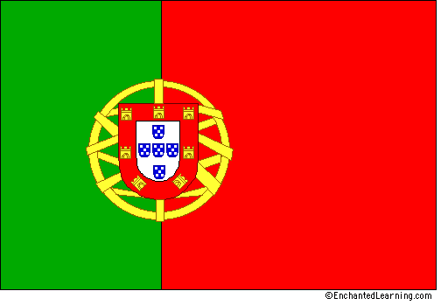

Spain, France,
Portugal, & Great Britain
All set up colonies in America

Slide 28

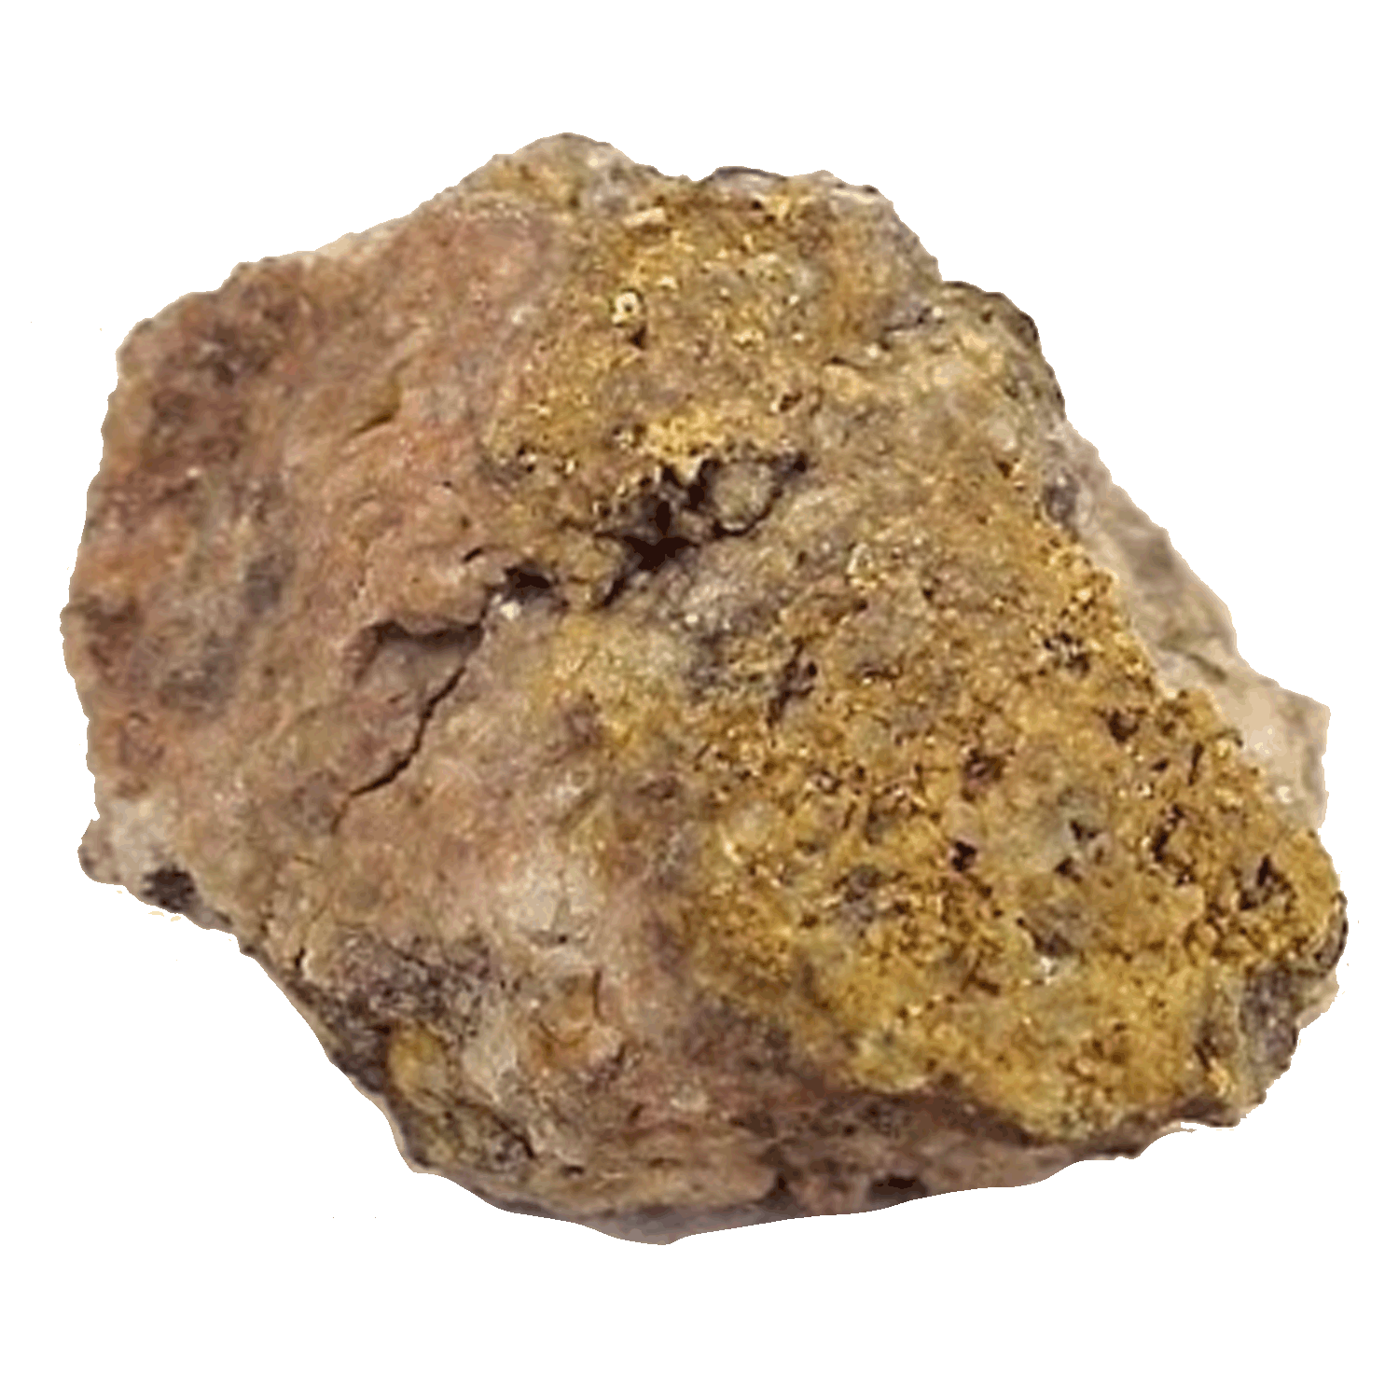
But what were the colonists looking for???
GOD, GOLD, GLORY
  Religious Freedom
  Money

Slide 29
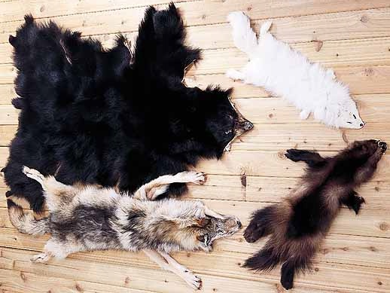
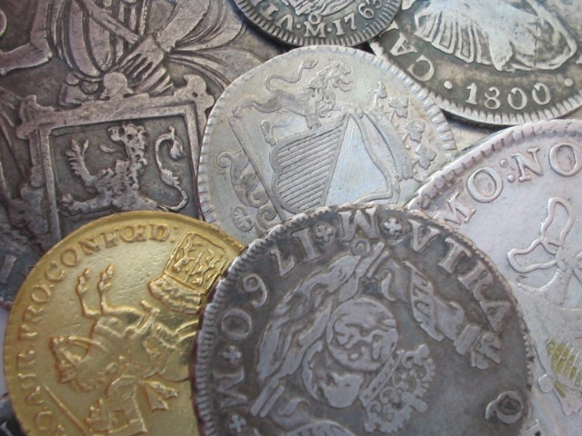
What were the mother countries looking for?
Wanted colonies to give them
gold, silver, furs, and cash crops!

Slide 30
QUESTIONS???

