Slide 1
Reasons For Exploration Continued

Slide 2
Types of Colonies
Trading Post Colony
Plantation Colony
Settler Colony

Slide 3
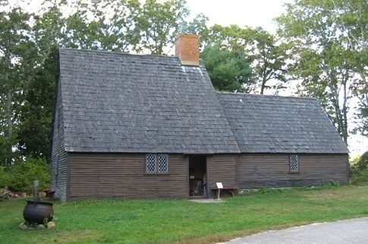
Trading Post Colony

Slide 4
Trading Post Colony
Trade Items along an established trade route.
The FRENCH established these in Canada to trade with the Native Americans.
The FRENCH were KIND to the Native Americans.

Slide 5
Plantation Colony
Large areas of land used to grow CASH CROPS
BRITISH colonists in the south grew cotton and tobacco.

Slide 6
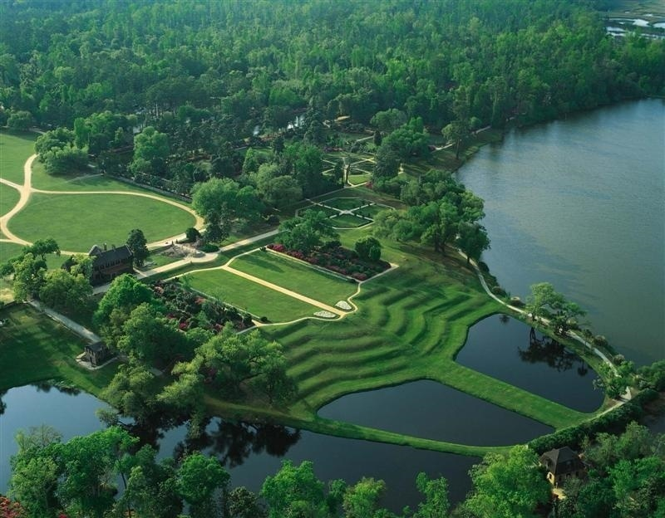
Middleton Plantation

Slide 7
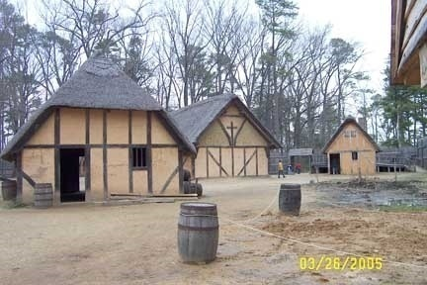
Settlement Colony

Slide 8
SETTLEMENT COLONY
Settlers build a town, but are linked to their mother country.
BRITISH COLONIES

Slide 9
Advantages of Colonization
1. New colonies provide land and raw materials
2. New colonies are a market to sell finished products to.
3. Colonists can be taxed, thus providing new revenue.

Slide 10
Disadvantages of Colonization
1. Forcing trade upon colonies interferes with a free market.
2. Mercantilism only exploits the resources of the new colonies.
3. Colonization creates tension towards the Mother Country.

Slide 11
Quick Quiz
List three new technological developments that helped Europeans travel across the globe.
What social changes took place due to colonial expansion.
If you were a colonist, what colonial development would you choose? Explain.
What was the exchange of goods from the New World to the Old World called?

Slide 12
QUESTIONS???

