Slide 1
Reasons For
Exploration Continued

Slide 2
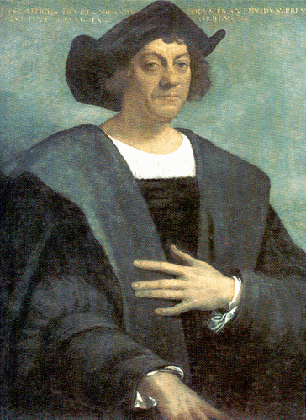
Christopher Columbus
Italian man
Looked WEST for route to Asia
Was given money by King Ferdinand and Queen Isabella from SPAIN.
Discovered land in 1492, but it wasn’t ASIA!!!

Slide 4
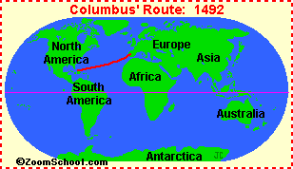
Dies believing he landed in India

Slide 5
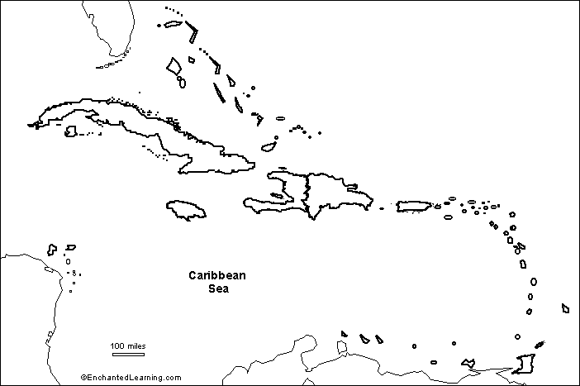
Hispaniola
Cuba
Dominican
Republic
Haiti
Jamaica
Puerto Rico

Slide 6
Magellan
Searched for passage to Pacific Ocean
Sailed through “straits of Magellan”
Died in Philippines
Crew 1st to circumnavigate the world

Slide 8
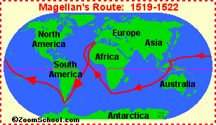
Magellan also named the Pacific Ocean (the name means
that it is a calm, peaceful ocean).

Slide 9
Prince Henry
a. Son of Portuguese King
b. Dazzled by dreams of ocean exploration and East Asia
c. Established a navigation school

Slide 10
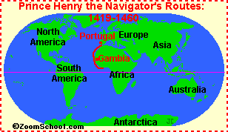

Slide 11
Ponce de Leon
1st to land on the mainland of North America
Looking for “fountain of youth”
Sailed for Spain
Established St. Augustine, Florida

Slide 12
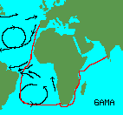
Vasco de Gama
First to sail around Africa to India (27,000 mi)
Obtained valuable goods from India

Slide 13
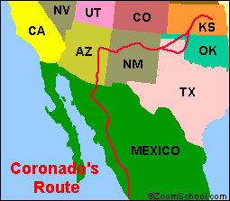
Coronado
Looking for fabled seven cities of gold
Explored present-day Arizona and New Mexico

Slide 14
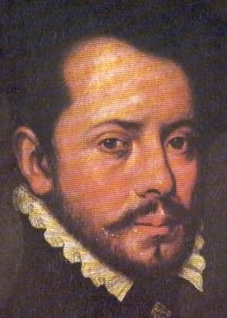
HERNANDO CORTES
Explored MEXICO
Conquered Aztec civilization
I am a CONQUISTADOR

Slide 15
Hernanando Cortes
Spanish Conquistador
Conquered Aztec emperor Montezuma
Found gold
claimed Mexico for Spain (1519-21)
"discovered" Tenochtitlan,

Slide 16
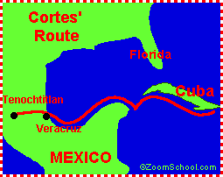

Slide 17
Balboa
Spanish Explorer
Claimed Pacific Ocean and adjoining lands for Spain
First to cross the Isthmus of Panama

Slide 18
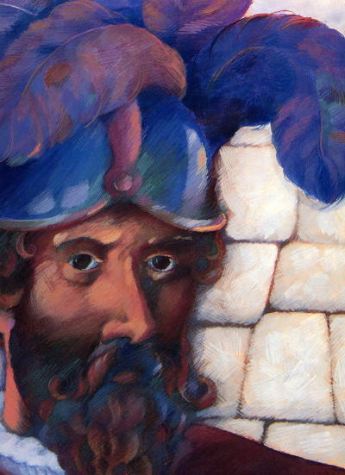
Pizzaro
Conquered the Incan Empire
Sailed for Spain

Slide 19
Amerigo Vespucci
Amerigo Vespucci
America was named after him
Recruited by Spain

Slide 20
QUESTIONS???

