Slide 1
Reasons For
Exploration Continued

Slide 2
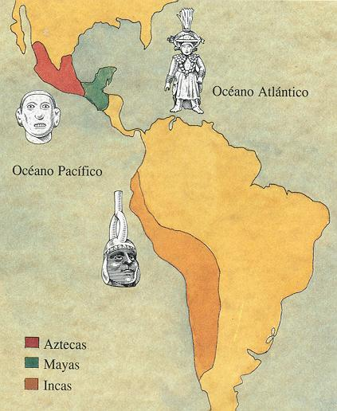
Civilization in the Americas

Slide 3
The Maya
The Mayan Empire:
Modern day Mexico, Guatemala, Honduras and El Salvador.
Constructed large cities.
Each city was ruled by a god-king.
Traded with each other.

Slide 4
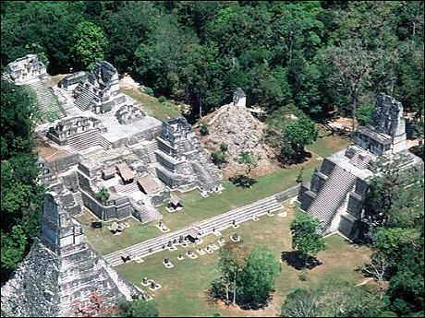
Tikal

Slide 5
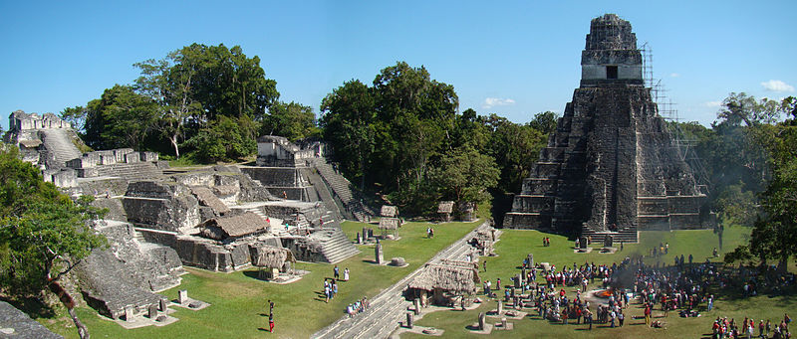
Tikal
Tikal was the capital of a conquest state that became one of the most powerful kingdoms of the ancient Maya.
the city dominated much of the Maya region politically, economically, and militarily, while interacting with areas throughout Mesoamerica such as the great metropolis of Teotihuacan in the distant Valley of Mexico.

Slide 6
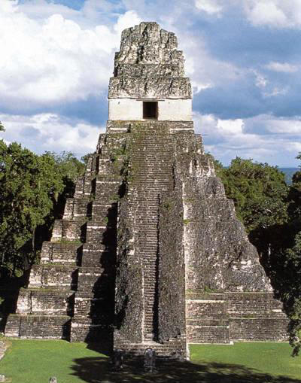
Tikal

Slide 7
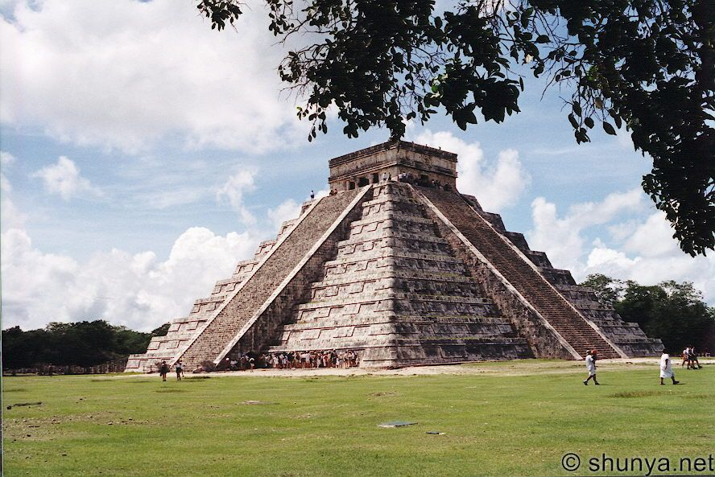
Chichen Itza

Slide 8
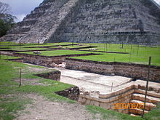
Chichen Itza
Chichen Itza was a major focal point in the northern Maya lowlands from the Late Classic (c.600–900 AD) through the Terminal Classic (c.800–900) and into the early portion of the Early Postclassic period (c.900–1200).
hichen Itza was one of the largest Maya cities and it was likely to have been one of the mythical great cities.

Slide 9
How did agriculture affect the Maya?
Depended heavily on agriculture.
Used terraces for farming.
Majority of goods traded were agricultural.

Slide 10
Mayan Society
Mayan religion was polytheistic.
Both good and bad gods.
Worshiped their gods in many ways.
Including human sacrifice.
Developed :
Calendars
Written language
Math

Slide 11
Mayan Society (cont.)
Maya also developed a class structure.
Nobles
Priests & Warriors
Merchants & Artisans
Peasants

Slide 12
What happened to the Mayas?
Mayan civilization declined about 700 A.D.
Arrival of Spanish.
Video Clip

Slide 13
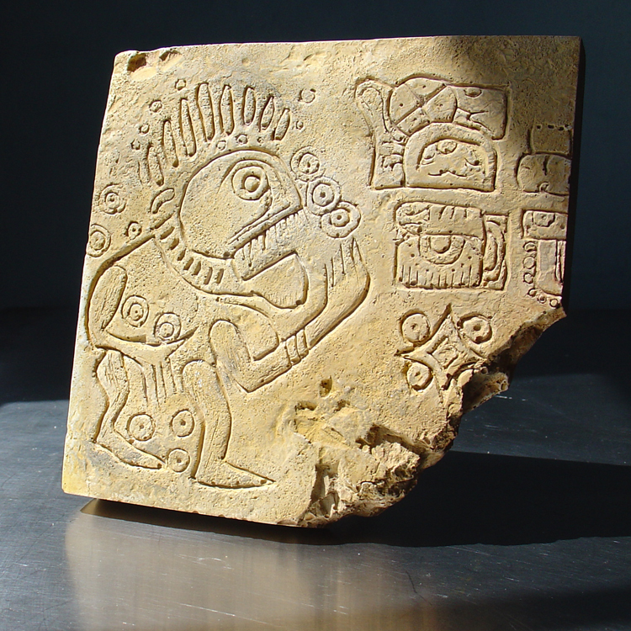
Mayan Hieroglyphics

Slide 14
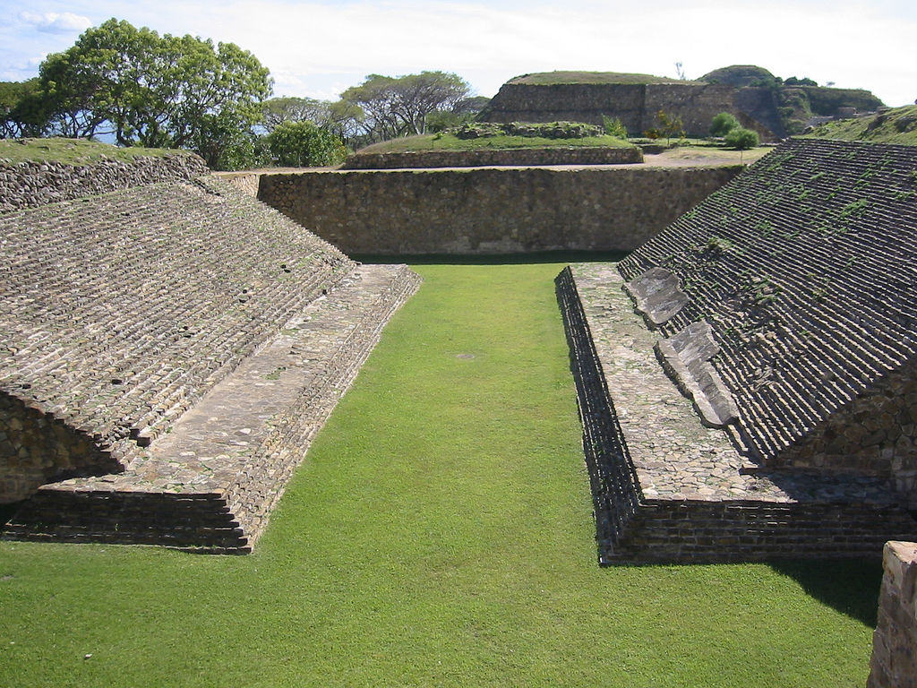
Mayan Ball Court

Slide 15
Aztec Empire
By 1200 the Aztecs took over the Valley of Mexico.
Mexico City
1500s Aztecs controlled 80,000 miles
Population 5-15 million.
Based their success on conquest.

Slide 16
Aztec Society
Aztec religion was polytheistic.
Practiced human sacrifice.
Conquered just to obtain sacrificial victims.
Developed :
Calendars
Written language
Math

Slide 17
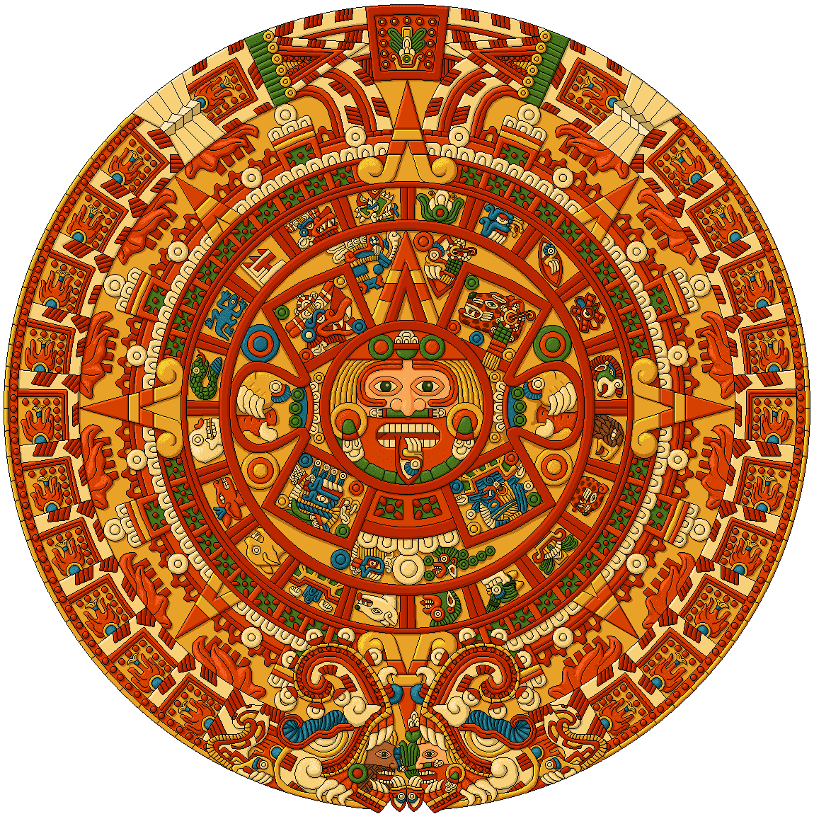
Aztec Calendar

Slide 18
Aztec Society (cont.)
Constructed elaborate cities.
highly decorated temples and large market places.
Constructed a road and canal system.
Connected the central city to outer areas.

Slide 19
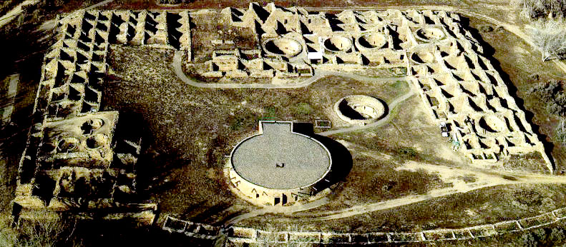
Aztec ruins

Slide 20
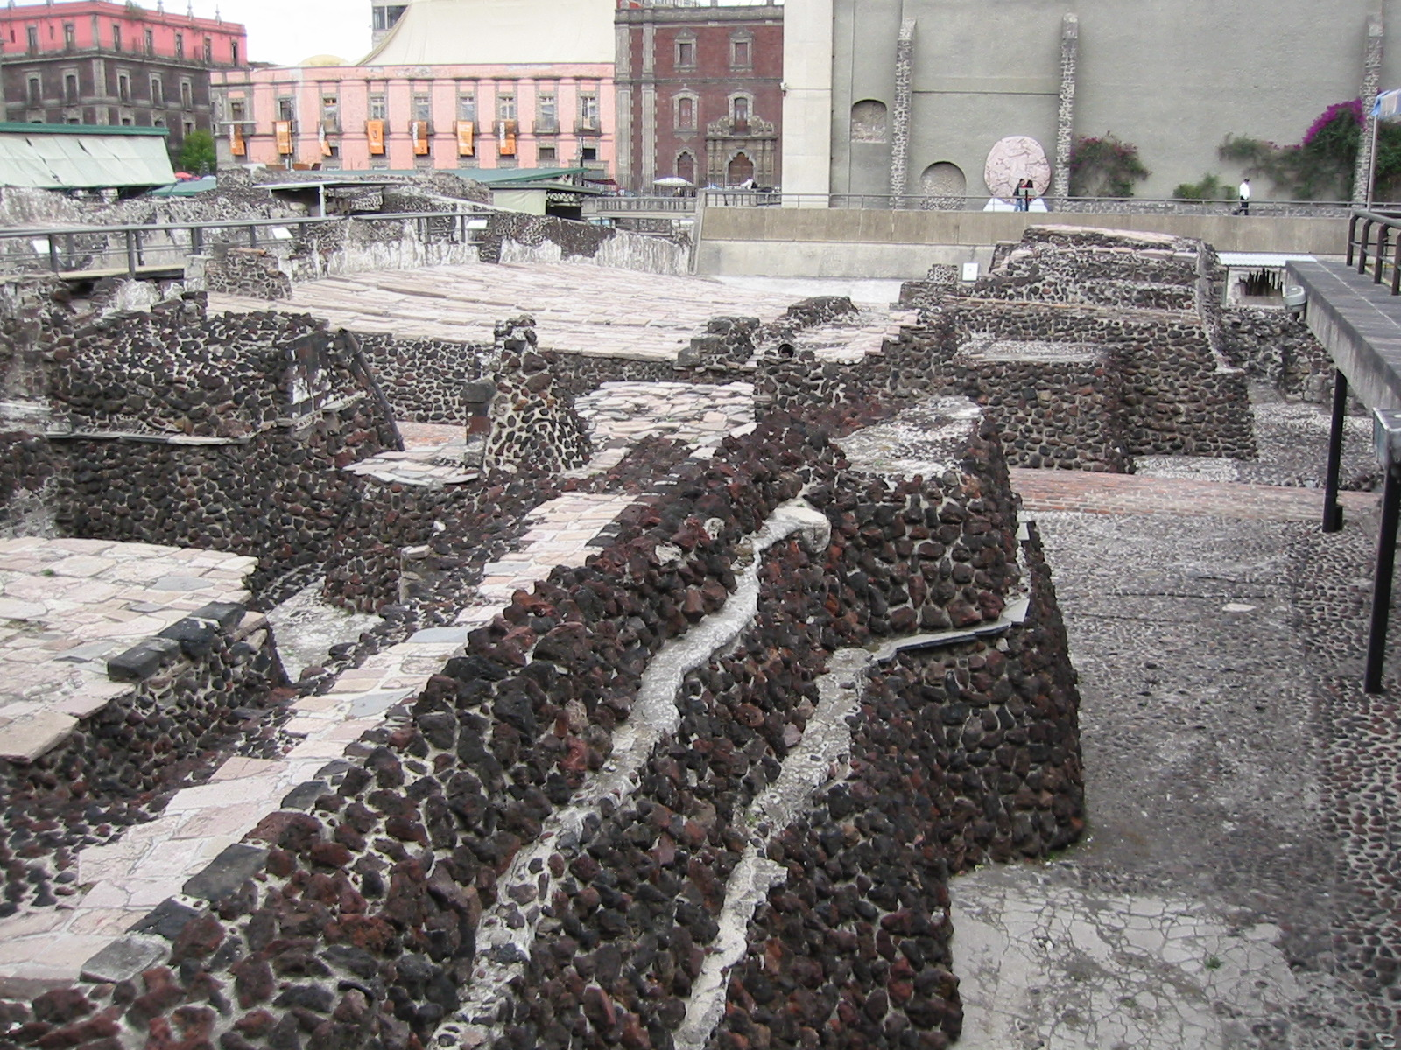
Aztec ruins-Mexico City

Slide 21
Aztec Society (cont.)
Emperor
Nobles (govt. officials, priests, generals)
Commoners (merchants,
soldiers, farmers)
Enslaved

Slide 22
What problems did the Aztec face?
Required even more sacrifice to honor the gods.
Caused people in outer areas to:
Hate the Aztecs .
Retaliate against the Aztecs.
Spanish arrived in early 1500s.
Led by Hernan Cortez (Conquistador- Spanish soldier, conqueror)
Used hate of Aztecs to his advantage.
video clip

Slide 23
Inca Empire
Developed in South America.
Ecuador, Peru and Chile.
Settled in Andes Mts.
By 1500 controlled 2,500 miles.
Population: 16 million.
Had a very powerful military.
But only used when necessary.

Slide 24
How did the Inca set up their society?
Any people they conquered were treated like other Incas.
Inca’s gained their loyalty.
The Inca were agriculturally based.
Used terraces.

Slide 25
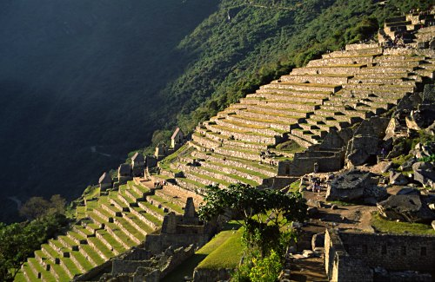
Incan terraces

Slide 26
Inca Society
Polytheistic society.
Created great cities.
Decorated in gold and silver.
Created schools to educate in Inca ways.
Road and bridge system to connect empire.

Slide 27
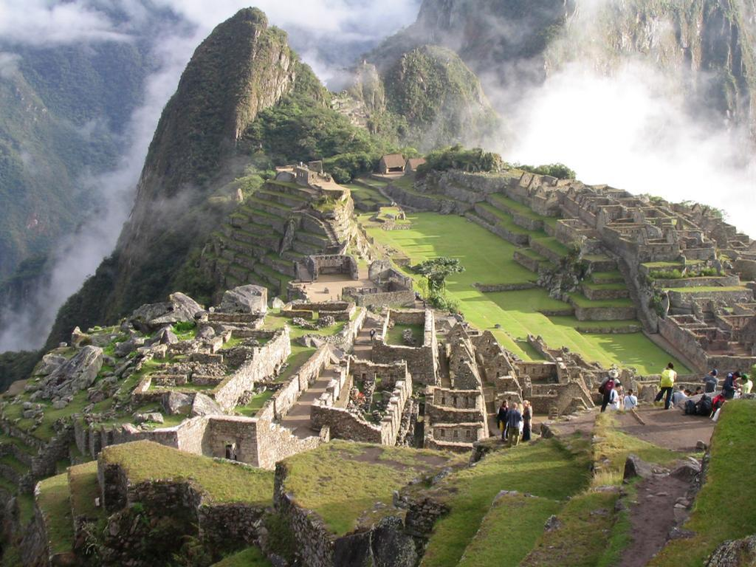
Machu Picchu

Slide 28
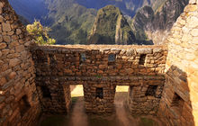
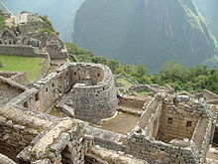
Machu Picchu
Most archaeologists believe that Machu Picchu was built as an estate for the Inca emperor Pachacuti.
Often referred to as the "City of the Incas", it is perhaps the most familiar icon of Inca civilization.
Since the site was never known to the Spanish during their conquest, it is highly significant as a relatively intact cultural site

Slide 29
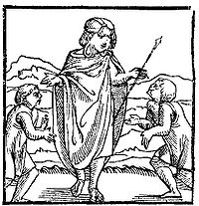
Inca society
In 1520s Inca empire became weak due to in-fighting.
1530s Spanish arrive at the Inca Empire.

Slide 30
In the Wake of Columbus The decline of native peoples: Central Mexico (Aztecs)
Population (in millions)
25.2
16.8
6.3
2.7
1.9
1.4
1.1
Year
1518
1532
1548
1568
1580
1595
1608
Use the information to make a line graph

Slide 31
Questions???

