Slide 1
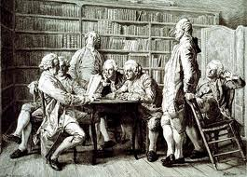
Science and Enlightenment

Slide 2
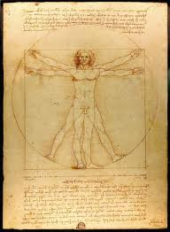
What were the results of Renaissance thoughts and theories

Slide 3
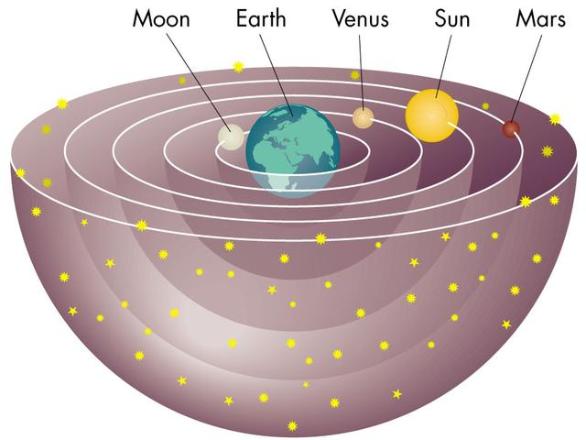
Before the Revolution
All ideas of science came from the Greeks & Bible
With new inventions came new ideas.
The Scientific Revolution= people discovering new theories about science

Slide 4
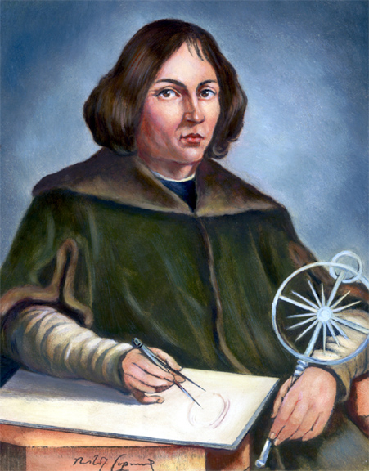
The Scientific Revolution
Copernicus discovered heliocentric theory is correct (Sun-centered); Geocentric theory is incorrect (Earth-centered)

Slide 5
The Scientific Revolution
Galileo furthered Copernicus’ ideas & was punished by the church (put on trial)

Slide 6
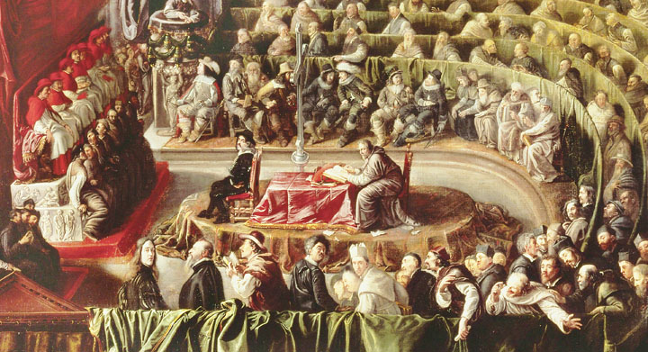
Galileo’s Trial

Slide 7
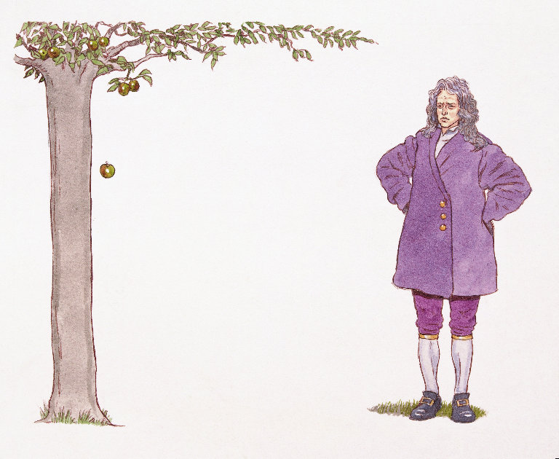
More Scientists
Sir Isaac Newton proved his Law of Gravity and 3 Laws of Motion:
Law of Inertia
Force= mass x acceleration
Every action has an equal and opposite reaction

Slide 8
More Scientists
Johannes Kepler
developed Laws of Planetary Motion which provided the basis for Newton’s theory of universal gravitation

Slide 9
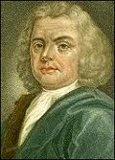
Medicine
In Medicine people began to dissect animals to understand the body
Andreas Vesalius- human anatomy
Herman Boerhaave- “father of physiology”

Slide 10
The Scientific Revolution
Eventually the Church allowed scientist to dissect the human body to understand it

Slide 11
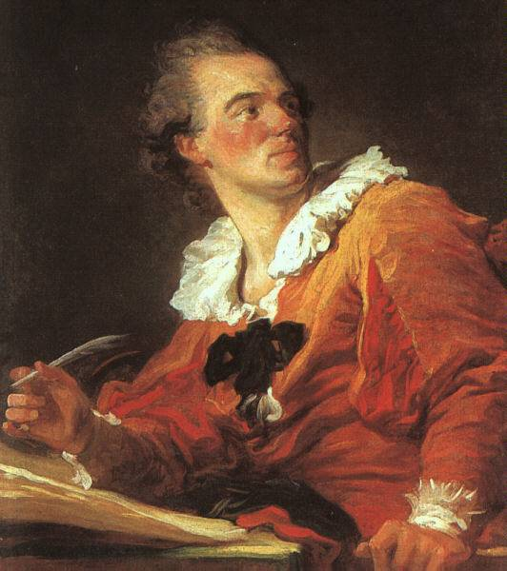
The Enlightenment Mid 1700’s
What happened next???
Notes:
The era known historically as the Enlightenment marks the intellectual beginning of the modern world. Ideas originating in this era would gradually spread around the world creating challenges to existing traditions and ways of governing. Many governments today have Enlightenment principles as the basis of their constitutions and forms of government. In addition, the expansion of suffrage to women, blacks, and people of all classes is a legacy of the Enlightenment. Enlightenment ideas on equality also helped end the dominance of social elites such as the aristocracy and the church. Enlightenment thought also led many countries to establish systems of public schools and put an end to the idea that education was only a privilege for the upper classes.
Note to teacher: The image in this slide is Jean-Honoré Fragonard’s “Inspiration,” which shows a philosophe at his desk lost deep in thought.

Slide 12
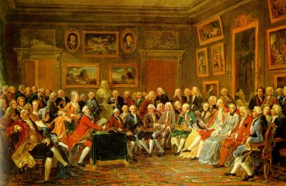
What Was the Enlightenment?
The Enlightenment was an intellectual movement in Europe during the 18th century that led to a whole new world view.
Notes:
When historians discuss the “Enlightenment,” they are usually referring to 18th-century Europe (France and England in particular), although other parts of the world (including the U.S.) are often included as well. The Enlightenment was a period of intellectual ferment that gave rise to a range of new theories about society, government, philosophy, economics, and religion. The period produced more than just abstract theorizing, however: it offered a whole new way of conceptualizing the world and one’s place in it. In many ways, this change in perception marked the beginning of the modern era, as institutions and traditions of the past began to shift—and even crumble—in the face of new ideas and approaches.
Note to teacher: The painting in this slide is Une soirée chez Madame Geoffrin. Created in 1755, it shows a French salon. Among the notable philosophes depicted in the painting are Diderot, d’Alembert, Turgot, and Condillac. A bust of Voltaire appears in the background.

Slide 13
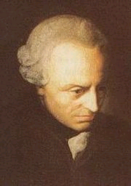
According to the 18th- century philosopher Immanuel Kant, the “motto” of the Enlightenment was “Sapere aude (dare to know)! Have courage to use your own intelligence!” (Kant, “What Is Enlightenment?” 1784)
Immanuel Kant
Notes:
The term “enlightenment” was first coined by Immanuel Kant, a German philosopher. “Sapere aude” means “dare to know” in Latin. Kant also wrote in this essay, “All that is required for this enlightenment is freedom; and particularly the least harmful of all that may be called freedom, namely, the freedom for man to make public use of his reason in all matters.” In other words, in order to be “enlightened,” a person had to think independently rather than simply follow society’s customs and traditions. Thus, the Enlightenment encouraged free thought (or at least freer and more wide-ranging thought than had occurred in the recent past).

Slide 14
The Scientific Revolution
The Enlightenment grew largely out of the new methods and discoveries achieved in the Scientific Revolution
The equatorial armillary, used for navigation on ships
Notes:
The most important factor in the development of the Enlightenment was the Scientific Revolution of the 16th and 17th centuries.

Slide 15
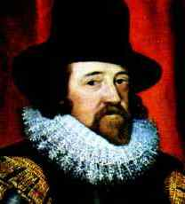
Francis Bacon and the Scientific Method
The scientific method
Observation and experimentation
Testable hypothesis
Sir Francis Bacon
Notes:
Sir Francis Bacon laid the theoretical groundwork for what became known as the scientific method. In Europe, science had been almost a combination of magic and academics, and scientists were not concerned with careful practices, methodical actions, logic, or theory. Bacon believed that all scientific research should rely on careful observation and experimentation rather than simply relying on one’s own thought and reasoning, as earlier scientific thinkers had. The data obtained should then be recorded and analyzed according to logic and reason, then used to produce a testable hypothesis.

Slide 16
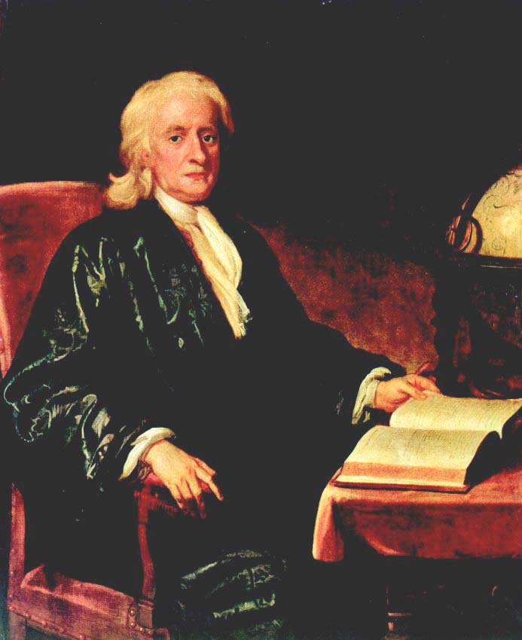
Isaac Newton and the Scientific Method
Used the scientific method to make a range of discoveries
Newton’s achievements using the scientific method helped inspire Enlightenment thinkers
Sir Isaac Newton
Notes:
Although earlier scientists had already put Bacon’s ideas into practice, Sir Isaac Newton is the scientist most associated with the scientific method. Newton made a range of groundbreaking discoveries in the fields of mathematics, physics, optics, and more. Newton’s achievements provided the inspiration for the Enlightenment: if the scientific method had worked so well for finding scientific truth, perhaps it could be applied to social sciences as well so that the truths about society itself could be discovered.

Slide 17
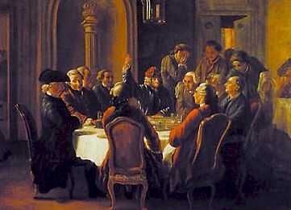
Enlightenment Principles
Religion, tradition, and superstition limited independent thought
Accept knowledge based on observation, logic, and reason, not on faith
Scientific and academic thought should be secular
A meeting of French Enlightenment thinkers
Notes:
The Enlightenment era was characterized by secularism, challenges to authority, and the glorification of reason.
Bullet #1 Many Enlightenment thinkers felt that although the great minds of the medieval and Renaissance eras had achieved much, they also had been overly constrained by religion, tradition, and superstition. To truly achieve independent thought, one had to throw off all limits and rely solely on reason.
Bullet #2 Like the pioneers of the Scientific Revolution, Enlightenment thinkers also strove to make conclusions based on observation, logic, and reason, rather than on faith.
Bullet #3 Enlightenment thinkers revived the spirit of the Renaissance quest for knowledge, choosing to focus on human nature and the workings of society rather than on spiritual matters and religious tenets. This secular approach led to the development of the social sciences.

Slide 18
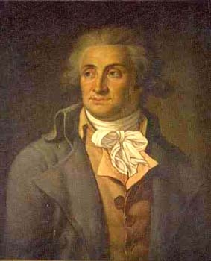
The Marquis de Condorcet
French mathematician
Sketch for a Historical Picture of the Progress of the Human Spirit
Played active role in the French Revolution
Notes:
The Marquis de Condorcet was a renowned mathematician who played an active role early on in the French Revolution, leading a redesign of the educational system and helping to write the first French constitution. When the Radicals (Jacobins) took over the Revolution, however, he went into hiding. During this time, he wrote his most famous work, Sketch for a Historical Picture of the Progress of the Human Spirit. His book provided a clear expression of many Enlightenment ideals: an unbending faith in “reason” as the means to discover all “truths,” continual advancements both in science and in social mores and attitudes, and a belief that humans can realistically strive for “perfectibility” in all areas of life.

Slide 19
Condorcet (continued)
Universal education (education for all)
Progress and “perfectibility,” the idea that people realistically strive for perfection in all areas of life.
Notes:
Condorcet felt that not just elite scientists and intellectuals could make great discoveries, but people of “ordinary intelligence” as well. He therefore favored “universal education,” stating that “by giving more people the elementary knowledge that can inspire them with a taste for more advanced study and give them a capacity for making progress in it…and that, therefore, the number of men destined to push back the frontiers of the sciences by their discoveries will grow in the same proportion.”
Condorcet firmly believed that a devotion to reason could ensure a better future. He stated that eventually “the progress of reason will have gone hand in hand with progress in the arts and sciences”; consequently, people would come to realize that “their object is the general welfare of the human species.” To this end, society would move towards providing a larger intellectual life for everyone, innovations that would ease the burden of labor on the working classes, freedom from want, and a greater “equality” among members of society. Condorcet’s optimistic belief in the “perfectibility” of society was shared by many Enlightenment thinkers.

Slide 20
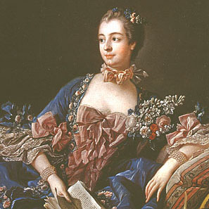
The French Salon and the Philosophes
Madame de Pompadour
Salons: gatherings for aristocrats to discuss new theories and ideas
Philosophes: French Enlightenment thinkers who attended the salons
Madame de Pompadour
Notes:
Madame de Pompadour, mistress of King Louis XV of France, was a devotee of art and philosophy. Around the middle of the 18th century, she began holding what became known as the salon. Salons were a sort of high class cocktail party for socialites, aristocrats, and intellectuals, where people demonstrated their knowledge of new theories and tried to outwit each other. Madame de Pompadour held the most famous and best attended salons in Paris.
Enlightenment thinkers in France who went to salons were known as philosophes. For a salon to be truly successful, it had to have a philosophe in attendance as a sort of showpiece.

Slide 21
The Encyclopédie
Major achievement of the philosophes
Begun in 1745; completed in 1765
Included the most up-to-date knowledge on the sciences, arts, and crafts
Frontspiece to the Encyclopédie
Notes:
Perhaps the most notable achievement of the philosophes as a group was the 17-volume Encyclopédie, known in English as Encyclopedia: The Rational Dictionary of the Sciences, the Arts, and the Crafts. In 1745, French publisher André le Breton asked writer Denis Diderot to help him translate the seminal English Cyclopedia into French. Diderot served as co-editor of the project along with mathematician Jean Le Rond d’Alembert.

Slide 22
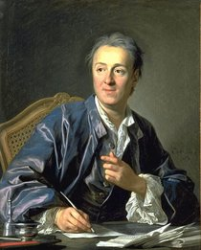
The Encyclopédie (continued)
Denis Diderot and Jean Le Rond d’Alembert
Banned by the Catholic Church
It contained nearly 72,000 articles accompanied by numerous illustrations
Encyclopédie editor Denis Diderot
Notes:
Shortly after beginning, Diderot came up with a much more ambitious goal than a mere translation. He wanted instead to create a comprehensive work that would include the most up-to-date knowledge on the sciences, arts, and crafts. To this end, he enlisted several of the best thinkers of the era—many of whom were well-known philosophes—to write new articles for the Encyclopédie. He also wanted to make the work accessible to a wide audience rather than just for scholars.
Although Diderot and d’Alembert ended up writing the majority of the articles, contributions also came from many noted figures (especially Voltaire, as well as Rousseau and Montesquieu). By the time the Encyclopédie finally reached completion, it contained nearly 72,000 articles accompanied by numerous illustrations.
The work as a whole represents an outstanding example of Enlightenment thought: it praised science while also questioning religion, social institutions, the legal system, and more. As a result, the Catholic Church viewed it as undermining its authority and placed the Encyclopédie on its index of forbidden works. Nevertheless, it was widely read, with people often obtaining cheaper reprint editions published in Switzerland.

Slide 23
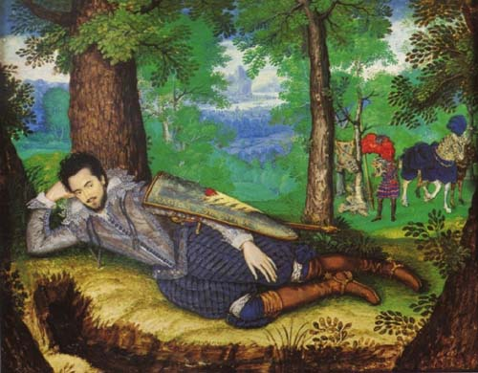
Deism
Deists believed in God but rejected organized religion
Morality could be achieved by following reason rather than the teachings of the church
Lord Edward Herbert of Cherbury, founder of deism
Notes:
Voltaire was also a deist, as were many other leading figures of the Enlightenment. Founded by Lord Edward Herbert in the early 1600s, the philosophy of deism took the technique of rational analysis and applied it to religion, coming up with conclusions that were not to the liking of many followers of Christianity. Deists firmly believed in God, but rejected organized religion. Rather than looking to the church or the supernatural for moral guidance, deists believed that morality could be achieved by following reason. Even though deism affirmed the existence of God, it discarded virtually all Church traditions and practices as irrational and unnecessary, a fact which led many to criticize deists as anti-Christian, or even to portray them as atheists.

Slide 24
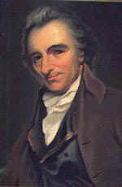
Deism (continued)
God/the creator is the “great watchmaker”
The idea that the universe operates like a watch.
Thomas Paine is a famous American Deist.
Thomas Paine
Notes:
Enlightenment philosophy emphasized experience and reason, while the Church asked worshipers to accept its principles on faith, so a conflict here was inevitable. Deists viewed God as the “great watchmaker” whose creation—the universe—operated as smoothly as a fine Swiss watch. The task, as Enlightenment thinkers envisioned it, was to try to discover the principles that governed the functioning of this “watch.” Deism thus centered around a belief in a God who operated according to reason and whose existence could be seen in the natural order and logic of all that He had created.
Thomas Paine, famous primarily for writing the classic pamphlet Common Sense, was also a key theorist of deism. In his essay “Of the Religion of Deism Compared with the Christian Religion,” Paine asserted that “there is a happiness in Deism, when rightly understood, that is not to be found in any other system of religion” because deism did not force its followers to “stifle reason” in order to accept its tenets.

Slide 25
How Rulers Ruled Before the Enlightenment
Divine Rights of Kings
The idea that rulers receive their authority from God and are answerable only to God.

Slide 26
Stop
Take a deep breath and let it out.
Continue breathing deeply and pull out a piece of paper.

Slide 27
Enlightenment Questions
1. What do you believe is the nature of human beings? Are people born inherently good or bad? Can people’s nature change? Explain your answers completely.
2. What would Mesa look like if there were no laws or police?
3. What would you do if you saw a person drop a $100 bill? Explain your reasoning.

Slide 28
QUESTIONS?

