Slide 1
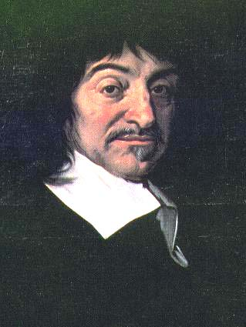
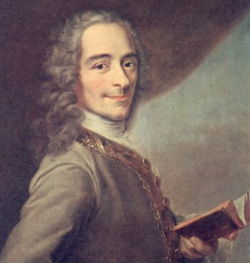
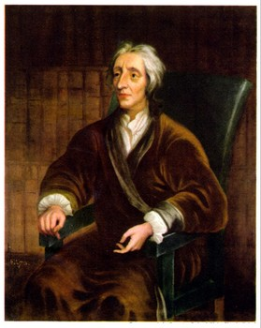
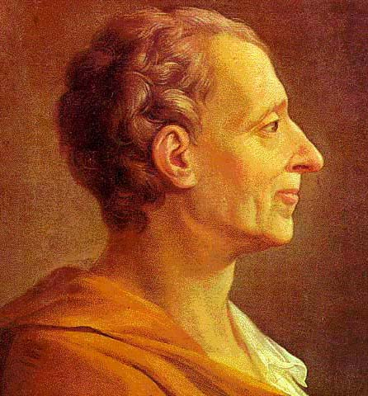
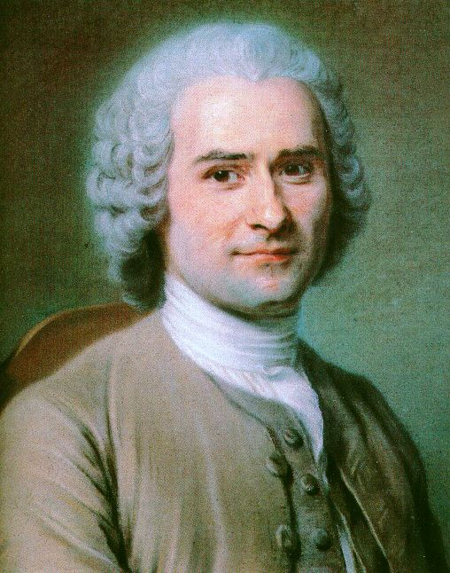
Enlightenment Thinkers
Notes:
Many Enlightenment thinkers were also mathematicians and scientists. They viewed changes in science as going hand in hand with changes in philosophy.

Slide 2
René Descartes (1596–1650)
French philosopher and mathematician
Questioned the basis of his own knowledge
“Cogito ergo sum”
“I think, therefore, I am.”
Notes:
René Descartes was one of the most important philosophers and mathematicians of the modern era. In Discourse on Method and The Meditations, he reasoned that all of his prior knowledge was subject to doubt because it was based on traditional beliefs rather than in rational, empirical thought. He pondered what he could honestly say he knew to be true, going so far as to doubt whether he was awake or dreaming—or if he even existed. He then began to reconstruct his world view: he knew that his thoughts existed, which then suggested the existence of a thinking being—himself. Descartes then came to his famous conclusion, “Cogito ergo sum,” which means “I think, therefore, I am.”

Slide 3
Voltaire (1694–1778)
Most famous philosophe
Wrote plays, essays, poetry, philosophy, and books
Attacked the “relics” of the medieval social order
Championed social, political, and religious tolerance
Notes:
François-Marie Arouet, known more famously as Voltaire, was the most renowned of the philosophes. A prolific writer, much of his work either satirized or attacked what he called the “relics” of the medieval social order—in particular, the church and the aristocracy. Despite—or perhaps because of—his controversial ideas, he was in high demand at salons not just in France but throughout Europe as well. He lived in the court of Frederick the Great for a time, and he was friends with Catherine the Great.
Above all, Voltaire attacked intolerance in society, politics, and religion. A famous quote usually attributed to Voltaire states, “I disapprove of what you say, but I will defend to the death your right to say it.” He felt that all governments were susceptible to tyranny, but he greatly admired the British model.

Slide 4
Voltaire (con’t)
Credited with the idea of freedom of speech.
He was very critical of the French government and the Roman Catholic Church.
Was imprisoned in the Bastille twice.
“I do not agree with what you have to say, but I'll defend to the death your right to say it”.

Slide 5
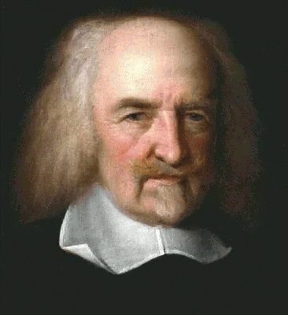
Thomas Hobbes (1588–1679)
Applied rational analysis to the study of government
Attacked the concept of divine right, yet supported a strong monarchy
People are naturally wicked and selfish (bad). People must voluntarily give an authoritarian figure the power to rule.
Notes:
Englishman Thomas Hobbes was one of the first thinkers to apply rational analysis to the study of government. In his famous work Leviathan, Hobbes attacked the notion of the “divine right of kings,” which held that monarchs ruled because they had been appointed by God. Instead, he believed that a ruler derived sovereignty from the implicit consent of the people. Not surprisingly, this radical concept met with near-universal disdain.
Although it seemed to many that Hobbes was attacking monarchy, in reality he favored having strong, authoritarian rulers because of conclusions he drew about human nature. Hobbes somewhat pessimistically believed that people were driven by their passions, and that only a powerful ruler could keep society from degenerating into conflict and chaos. Without a monarch to exercise control, Hobbes wrote that people’s lives would be “solitary, poor, nasty, brutish, and short.”

Slide 6
John Locke (1632–1704)
People have the ability to reason and can compromise (people are good).
If Gov. doesn’t govern justly the people must over through it and establish a government that is just.
Tabula rasa (a “Blank slate”)
Notes:
Bullet #1 John Locke, another English theorist, also disagreed with the notion of divine right; however, he held a very different view of human nature than Hobbes did. Locke posited that in the past, before people formed societies, they lived in a “state of nature.” He believed that all men were equal in the state of nature because they were “creatures of the same species and rank” with the “same advantages” and “same faculties.”
Bullet #2 Locke also had an interest in how humans learn. In his Essay Concerning Human Understanding, he argued that the mind of a newborn baby was a “tabula rasa”—a “blank slate” upon which environment and experience would transcribe ideas and beliefs. Locke saw human nature as something that was externally determined rather than internally determined; correspondingly, he stressed the importance of education.

Slide 7
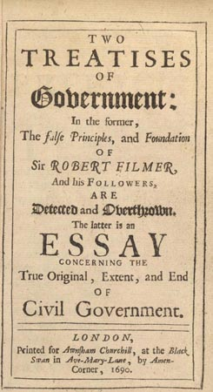
Locke (continued)
In Treatises of Government he attack DRo’K and Authoritarian Government
Believed in Natural Rights which he defined as “Life, Liberty, and Property.”
Notes:
Bullet #1 In his two Treatises of Government, Locke attacked the divine right of kings and authoritarian government. He promoted a constitutional monarchy that derived its power from the law and from the consent of the people. He also believed that a government’s primary responsibility was to protect individual property: he wrote, “The great and chief end, therefore, of men uniting into commonwealths, and putting themselves under government, is the preservation of their property; to which in the state of Nature there are many things wanting.”
Bullet #2 Locke believed that in the state of nature, individuals had natural rights, which he referred to as “all the rights and privileges of the law of Nature.” Locke claimed that one such right was to defend one’s “property” (which he defined as “his life, liberty, and estate”) against the “injuries and attempts of other men.” Locke built on this assumption, suggesting that if any ruler or government violated these natural rights, the people would have the right to change the government—by force if necessary.

Slide 8
Jean-Jacques Rousseau (1712–1778)
Believed that people are good but corrupted by society.
Believed in Direct Democracy (individual vote).
People are not truly free if they don’t make their own decisions.
The Social Contract
Notes:
Like Locke, Jean-Jacques Rousseau also used the concept of a “state of nature” to draw conclusions about society and government.
Rousseau is probably best known for his idea of the “social compact,” which he outlined in his book The Social Contract. Locke had viewed societies as having been created through mutual consent of all members. Rousseau went a step further, claiming that instead of mere consent, individuals forming a society entered into a “social compact” with one another. The social compact balanced benefits with obligations. Those who entered into it would receive mutual protection and defense, along with assistance in overcoming obstacles that they could not conquer individually. In return, the social compact obligated members of society to subordinate their “natural liberty” (i.e., the freedom enjoyed by individuals in the state of nature) to “the supreme direction of the general will.”

Slide 9
Baron de Montesquieu (1689–1755)
Developed the idea of separation of powers.
The Spirit of the Laws states that governmental power should be balanced among three branches.
Notes:
The Baron de Montesquieu was a French nobleman whose primary contributions to the Enlightenment’s political thought came in his 1748 treatise The Spirit of the Laws. Years before writing the treatise, Montesquieu had visited several European countries, carefully observing the workings of each nation’s government. In The Spirit of the Laws, he laid out a comparative study of types of governments, then put forward his own theory of government.

Slide 10
Montesquieu (continued)
The Spirit of the Laws
Three Branches of Gov.
Executive =
Carry out (enforce) laws.
Legislative =
Create laws.
Judicial =
Interpret laws.
Notes:
Montesquieu identified three sorts of governmental power: legislative, executive “in respect to things dependent on the law of nations,” and executive “in regard to those things that depend on civil law” (i.e., the judiciary). Montesquieu believed that if one person or group of people held any two or all three of these powers, it would result in “tyrannical laws” executed in a “tyrannical manner.” His ideas here provided the basis for the doctrine known as “separation of powers,” which significantly influenced the framers of the U.S. Constitution and thus the shaping of the American government.
Montesquieu did not believe that democracy was the best form of government. Instead, he favored a constitutional monarchy based on the British model. He greatly admired Britain’s government because he felt that Parliament, the king, and the courts worked separately and efficiently since each could limit the power of the other. This idea of the different branches of government each preventing the others from obtaining too much power later led to the theory of “checks and balances,” which also influenced the framers of the U.S. Constitution.

