Slide 1
Women and the Enlightenment

Slide 2
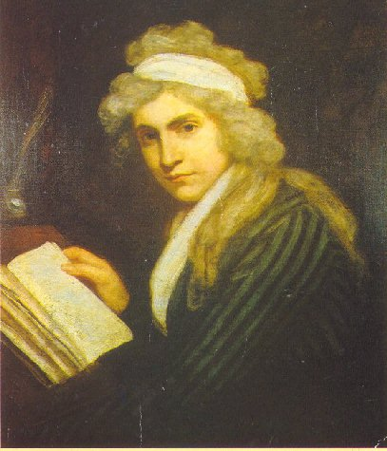
Women and the Enlightenment
Changing views of women’s role in society
Role of education
Equality
Olympe de Gouges
Mary Wollstonecraft
Notes:
One of the offshoots of Enlightenment philosophy was a changed view of the role of women in society. Enlightenment thinkers held reason supreme and valued education as the best way to develop a person. They also viewed education as crucial for moral development and for society to function as close to ideal as possible. Many thinkers, therefore, advocated education for women; however, they differed on the specific things they believed women should be taught, and most male thinkers did not extend their arguments to advocate full equality for women. Not surprisingly, some women disagreed with this position and wrote important works advocating equality for women.

Slide 3
Mary Wollstonecraft
A Vindication of the Rights of Women.
Believed that equal rights should be extended to women.
Had the same natural rights and intellectual capacity as men.
Notes:
During the early days of the French Revolution, the National Assembly adopted the Declaration of the Rights of Man. The document drew equally upon Enlightenment ideas and current events at the time to make statements both about basic political rights and the particular abuses which many had suffered under the rule of Louis XVI.
In 1792, Mary Wollstonecraft, a teacher and writer from Great Britain, composed A Vindication of the Rights of Women. Wollstonecraft had been living in Paris during the French Revolution and knew many of its leaders. The publication of the Declaration prompted her to outline her philosophy on the inequalities that existed between the sexes. She was disheartened by the fact that in spite of their belief in equality, the leaders of the Revolution did not extend that equality to women. She saw this as hypocritical and hoped her work would convince French leaders (especially Talleyrand, to whom she dedicated the book) to recognize that women had the same natural rights and intellectual capacity as men.

Slide 4
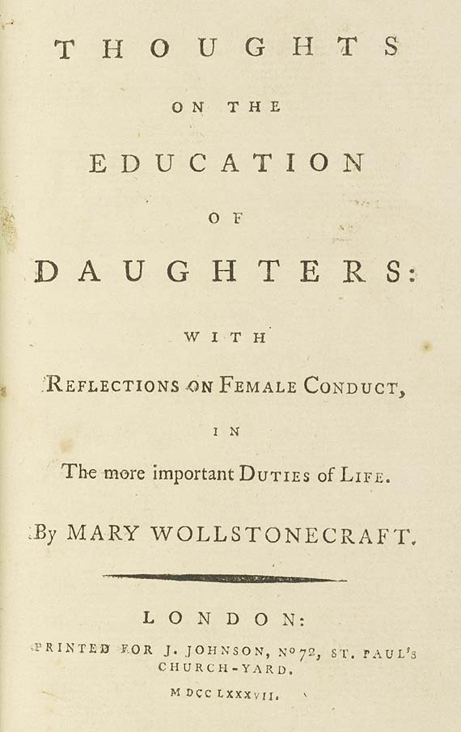
Wollstonecraft (continued)
The start of modern Women’s rights movement
Title page of Wollstonecraft’s Thoughts on the Education of Daughters
Notes:
Wollstonecraft believed women were kept in ignorance “under the specious name of innocence.” She refers here to a common argument of the time which held that women should not be educated because it would ruin their natural “innocence” and have a detrimental effect on their character. She felt that denying education to women would deprive them of the tools they needed to properly exercise their reason.
In the first chapter of her book, Wollstonecraft proclaimed, “It is time to effect a revolution in female manners—time to restore to them their lost dignity—and make them, as a part of the human species, labour by reforming themselves to reform the world.” Many regard A Vindication of the Rights of Women as marking the beginning of the modern women’s rights movement.

Slide 5
Olympe De Gouges
Criticized the French Revolution
The Rights of Women
“Declaration of the Rights of Woman and the Female Citizen”
Executed in 1793
Notes:
Olympe de Gouges also lived in Paris during the French Revolution and also produced a response to the Declaration of the Rights of Man. Her 1791 work, The Rights of Women, criticized the leaders of the Revolution for continuing to “oppress” women even though they had just been freed from oppression themselves. The heart of The Rights of Women consisted of a “Declaration of the Rights of Woman and the Female Citizen” that mimicked the language of the Declaration. For example, while Article 1 of the original Declaration stated that, “Men are born and remain free and equal in rights. Social distinctions may be founded only upon the general good.” Article 1 of de Gouges’ declaration says, “Woman is born free and lives equal to man in her rights. Social distinctions can be based only on the common utility.”
De Gouges also included a form for a “Social Contract Between Men and Women.” Much more strident in tone than Wollstonecraft, de Gouges urged women to “wake up” and “discover your rights.” She harshly criticized the Revolution, asking, “Oh, women, women! When will you cease to be blind? What advantage have you received from the Revolution? A more pronounced scorn, a more marked disdain.” She also decried the bloodshed of the Revolution, which led many to label her as a reactionary. In 1793, she was guillotined.

