Slide 1
Exchange Rates
And Comparative Advantage

Slide 2
Exchange Rates
When trade is free—unimpeded by government-instituted barriers—patterns of trade and trade flows result from the independent decisions of thousands of importers and exporters and millions of private households and firms.
To understand these patterns we must learn about exchange rates.

Slide 3
Exchange Rates
An exchange rate is the ratio at which two currencies are traded, or the price of one currency in terms of another.
For any pair of countries, there is a range of exchange rates that can lead automatically to both countries realizing the gains from specialization and comparative advantage.

Slide 4
Trade and Exchange Rates in a Two-Country/Two-Good World
Exchange rates determine the terms of trade.
Domestic Prices of Timber (Per Foot) and Rolled Steel (Per Meter) in the United States and Brazil
 | UNITED STATES | BRAZIL
Timber | $1 | 3 Reals
Rolled steel | $2 | 4 Reals
The option of buying at home or importing will depend on the exchange rate.

Slide 5
Trade and Exchange Rates in a Two-Country/Two-Good World
Trade Flows Determined by Exchange Rates
EXCHANGE RATE | PRICE OF REAL |  | RESULT
$1 = 1 R | $1.00 |  | Brazil imports timber and steel
$1 = 2 R | .50 |  | Brazil imports timber
$1 = 2.1 R | .48 |  | Brazil imports timber; United States imports steel
$1 = 2.9 R | .34 |  | Brazil imports timber; United States imports steel
$1 = 3 R | .33 |  | United States imports steel
$1 = 4 R | .25 |  | United States imports timber and steel

Slide 6
Exchange Rates and Comparative Advantage
If exchange rates end up in the right ranges, the free market will drive each country to shift resources into those sectors in which it enjoys a comparative advantage.
Only those products in which a country has a comparative advantage will be competitive in world markets.

Slide 7
The Sources of Comparative Advantage
Factor endowments refer to the quantity and quality of labor, land, and natural resources of a country.
Factor endowments seem to explain a significant portion of actual world trade patterns.

Slide 8
The Heckscher-Ohlin Theorem
The Heckscher-Ohlin theorem is a theory that explains the existence of a country’s comparative advantage by its factor endowments.
According to the theorem, a country has a comparative advantage in the production of a product if that country is relatively well endowed with inputs used intensively in the production of that product.
Notes:
Edward Leamer of UCLA has concluded that a short list of factors accounts for a large portion of world trade patterns. Natural resources, knowledge capital, physical capital, land, and skilled and unskilled labor.

Slide 9
Other Explanations for Observed Trade Flows
Product differentiation is a natural response to diverse preferences within an economy, and across economies.
Some economists also distinguish between gains from acquired comparative advantage and gains from natural comparative advantages.
Notes:
Because evidence suggests that economies of scale are exhausted at relatively small size in most industries, it seems unlikely that they constitute a valid explanation of world trade patterns.

Slide 10
Other Explanations for Observed Trade Flows
Economies of scale may be available when producing for a world market that would not be available when producing for a limited domestic market.
Notes:
Because evidence suggests that economies of scale are exhausted at relatively small size in most industries, it seems unlikely that they constitute a valid explanation of world trade patterns.

Slide 11
Trade Barriers: Tariffs, Export Subsidies, and Quotas
Protection is the practice of shielding a sector of the economy from foreign competition.
A tariff is a tax on imports.
A quota is a limit on the quantity of imports.
Notes:
The average tariff on imports into the United States is about 5 percent.
A U.S. firm attempting to monopolize a domestic market violates the Sherman Antitrust Act of 1890, prohibiting predatory pricing.
The Comprehensive Trade Act of 1988 contains clauses that permit the president to impose trade sanctions when investigations reveal dumping by foreign companies or countries.

Slide 12
Trade Barriers: Tariffs, Export Subsidies, and Quotas
Export subsidies are government payments made to domestic firms to encourage exports.
Dumping refers to a firm or industry that sells products on the world market at prices below the cost of production.
Notes:
The average tariff on imports into the United States is about 5 percent.
A U.S. firm attempting to monopolize a domestic market violates the Sherman Antitrust Act of 1890, prohibiting predatory pricing.
The Comprehensive Trade Act of 1988 contains clauses that permit the president to impose trade sanctions when investigations reveal dumping by foreign companies or countries.

Slide 13
U.S. Trade Policies and GATT
The Smoot-Hawley tariff was the U.S. tariff law of the 1930s, which set the highest tariff in U.S. history (60 percent). It set off an international trade war and caused the decline in trade that is often considered a cause of the worldwide depression of the 1930s.
Notes:
The most recent round of world trade talks sponsored by GATT, the “Uruguay Round,” began in Uruguay in 1986. The “final Act” of the Uruguay Round of negotiations is the most comprehensive and complex multilateral trade agreement in history.

Slide 14
U.S. Trade Policies and GATT
The General Agreement on Tariffs and Trade (GATT) is an international agreement signed by the United States and 22 other countries in 1947 to promote the liberalization of foreign trade.
Notes:
The most recent round of world trade talks sponsored by GATT, the “Uruguay Round,” began in Uruguay in 1986. The “final Act” of the Uruguay Round of negotiations is the most comprehensive and complex multilateral trade agreement in history.

Slide 15
Economic Integration
Economic integration occurs when two or more nations join to form a free-trade zone.
The European Union (EU) and the North American Free-Trade Agreement NAFTA are examples of economic integration.

Slide 16
Economic Integration
The European Union (EU) is the European trading bloc composed of Austria, Belgium, Denmark, Finland, France, Germany, Greece, Ireland, Italy, Luxembourg, the Netherlands, Portugal, Spain, Sweden, and the United Kingdom.

Slide 17
Economic Integration
The U.S.-Canadian Free-Trade Agreement is an agreement in which the United States and Canada agreed to eliminate all barriers to trade between the two countries by 1988.
Notes:
NAFTA was ratified by the U.S. Congress in late 1993 and went into effect on the first day of 1994.

Slide 18
Economic Integration
The North American Free-Trade Agreement (NAFTA) is an agreement signed by the United States, Mexico, and Canada in which the three countries agreed to establish all of North America as a free-trade zone.
Notes:
NAFTA was ratified by the U.S. Congress in late 1993 and went into effect on the first day of 1994.

Slide 19
The Case for Free Trade
The case for free trade is based on the theory of comparative advantage. When countries specialize and trade based on comparative advantage, consumers pay less and consume more, and resources are used more efficiently.
When tariffs and quotas are imposed, some of the gains from trade are lost.

Slide 20
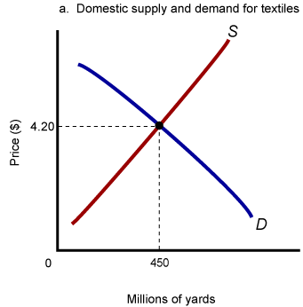
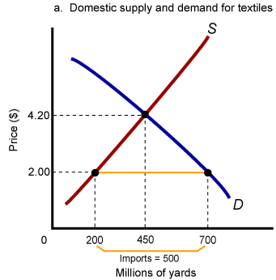
The Gains from Trade
When world price is $2, domestic quantity demanded rises, and quantity supplied falls. U.S. supply drops and resources are transferred to other sectors.

Slide 21
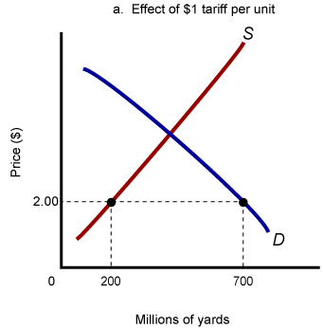
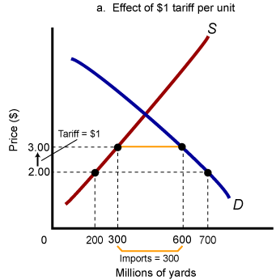
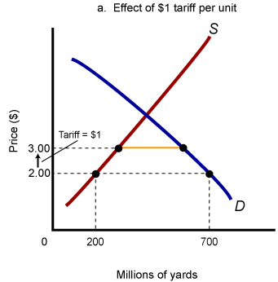
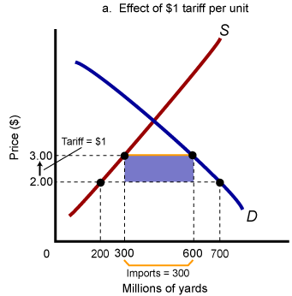
The Losses from the Imposition of a Tariff
The loss of efficiency from a $1 tariff:
Consumers must pay a higher price for goods that could be produced at a lower cost.
Marginal producers are drawn into textiles and away from other goods, resulting in inefficient domestic production.
Government revenue equals the shaded area.

Slide 22
The Case for Protection
Protection saves jobs
Some countries engage in unfair trade practices
Cheap foreign labor makes competition unfair
Protection safeguards national security
Protection discourages dependency
Protection safeguards infant industries
Notes:
We can ban imports and give up the gains from free trade, acknowledging that we are willing to pay premium prices to save domestic jobs in industries that can produce more efficiently abroad. Or we can retrain workers for jobs with a future, or adopt programs to relocate people in expanding regions.
An infant industry is a young industry that may need temporary protection from competition from the established industries of other countries in order to develop an acquired comparative advantage.

Slide 23
The Case for Protection
An infant industry is a young industry that may need temporary protection from competition from the established industries of other countries to develop an acquired comparative advantage.
Notes:
We can ban imports and give up the gains from free trade, acknowledging that we are willing to pay premium prices to save domestic jobs in industries that can produce more efficiently abroad. Or we can retrain workers for jobs with a future, or adopt programs to relocate people in expanding regions.
An infant industry is a young industry that may need temporary protection from competition from the established industries of other countries in order to develop an acquired comparative advantage.

Slide 24
QUESTIONS????

