Slide 1
The Legislative Branch
How a Bill becomes a law

Slide 2
How does a Bill become a law?
Bills- proposed laws, or drafts of laws presented to the House or Senate for enactment.
Two types:
Public- measure applying to the nation as a whole- (tax bills)
Private-only apply to certain persons or places rather than to the nation generally.

Slide 3
How does a Bill become a law?
Only members may introduce bills to the house.
The clerk of the house numbers each bill and gives it a short title
The bill is referred to a standing committee, where most bills die.
Discharge petition: enables members to force a bill that has been in committee 30 days.

Slide 4
How does a Bill become a law?
Subcommittees: divisions of existing committees, holds public hearings or may take a junket, or trip to an area affected by a measure.
Committee’s choices
“do pass”
Pigeonhole: refuse to report
Support with unfavorable recommendation.
Report a committee bill

Slide 5
How does a Bill become a law?
The House Debates the bill
The House votes on the bill
Amendments can be added during this time.
Voting is now electronic
Same process in the Senate
If versions are the same it goes to the president.
If versions are different it goes to a conference committee.

Slide 6
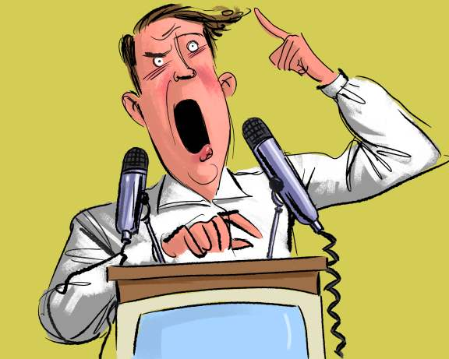
THE FILIBUSTER
Filibuster: an attempt to “talk a bill to death.” in the senate.
Record: Senator Strom Thurmond: held the floor for 24 hours in an attempt to kill the Civil Rights Act of 1957.

Slide 7
STUDENT CONGRESS
It’s your turn!!! As a class we will Write a Bill and track it through all of the steps needed in order to become the law. Are you ready?

Slide 8
CONGRATULATIONS!!!
Everyone is class is now an elected member of Congress.
DAY ONE:
Activity

Slide 9
DAY ONE:
Your teacher will assign you into ‘Sub-Committees’, where you will work together to draft a bill on an issue that is important to you.
Activity

Slide 10
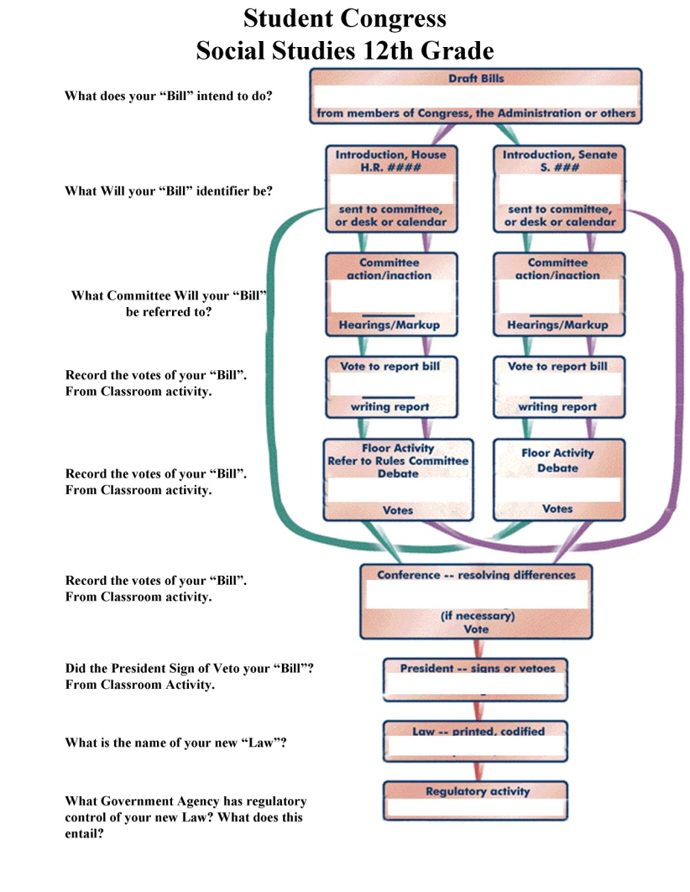
STUDENT CONGRESS
Discuss This
As a group.
Activity

Slide 11
STUDENT CONGRESS
Give your Bill an
Identifier
(ex. HR1 or S1)
Activity

Slide 12
STUDENT CONGRESS
What Committee
would hear this Bill in Congress?
Activity

Slide 13
STUDENT CONGRESS
Let’s Take a Vote!
Activity

Slide 14
STUDENT CONGRESS
Let’s Take a Vote!
And Again!
Activity

Slide 15
STUDENT CONGRESS
Let’s Take a Vote!
Almost There!
Activity

Slide 16
STUDENT CONGRESS
Did your Bill get signed in Law?
Activity

Slide 17
STUDENT CONGRESS
Our new Law is called
______________!
Activity

Slide 18
STUDENT CONGRESS
Who is going to enforce this new Law?
Activity

Slide 19
STUDENT CONGRESS
Let’s see how it went!!!
Discussion

Slide 20
What are the challenges Congressperson’s face when trying to pass a law?
Discussion

Slide 21
How many Bills does Congress write every year?
How many pass?
Discussion

Slide 22
Is every Bill in Congress Controversial?
Discussion

Slide 23
Let’s Discuss what we learned!
Discussion

