Slide 1
FEDERAL BUDGET 101

Slide 2
Where Does the Money Go?
In fiscal year 2014, the federal government will spend around $3.8 trillion. These trillions of dollars make up a considerable chunk – around 22 percent – of the US. economy, as measured by Gross Domestic Product (GDP). That means that federal government spending makes up a sizable share of all money spent in the United States each year. So, where does all that money go?

Slide 3
Mandatory and Discretionary Spending
The U.S. Treasury divides all spending into three groups: mandatory spending and discretionary spending and interest on debt. Interest on debt, which is much smaller than the other two categories, is the interest the government pays on its accumulated debt, minus interest income received by the government for assets it owns. This pie chart shows all projected federal spending in 2014 broken into these three categories.

Slide 4
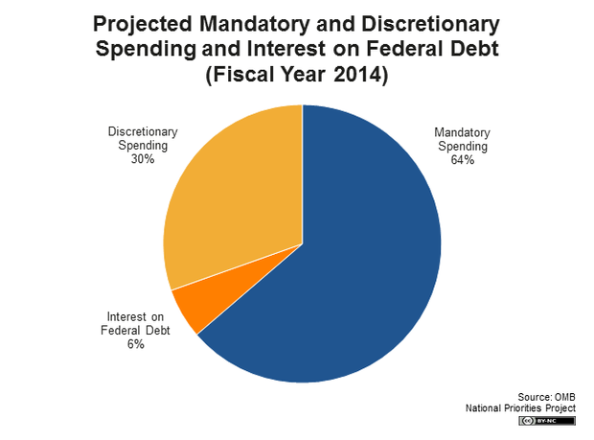

Slide 5
Discretionary spending
Discretionary spending refers to the portion of the budget which goes through the annual appropriations process each year. In other words, Congress directly sets the level of spending on programs which are discretionary. Congress can choose to increase or decrease spending on any of those programs in a given year.

Slide 6
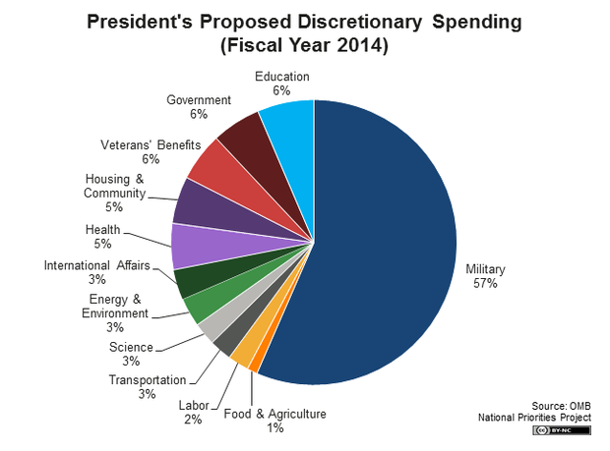

Slide 7
Mandatory spending
Mandatory spending is largely made up of earned-benefit or entitlement programs, and the spending for those programs is determined by eligibility rules rather than the appropriations process. For example, Congress decides to create a program like the Supplemental Nutrition Assistance Program (SNAP), also known as food stamps. It then sets criteria for determining who is eligible to receive benefits from the program. The amount of money spent on SNAP each year is then determined by how many people are eligible and apply for benefits.

Slide 8
Mandatory spending
Congress therefore cannot decide each year to increase or decrease the budget for SNAP. Instead, it can review the eligibility rules and may change them in order to exclude or include more people.
Mandatory spending makes up around two-thirds of the total federal budget. The largest mandatory program is Social Security, which comprises more than a third of mandatory spending and around 22 percent of the total federal budget.

Slide 9
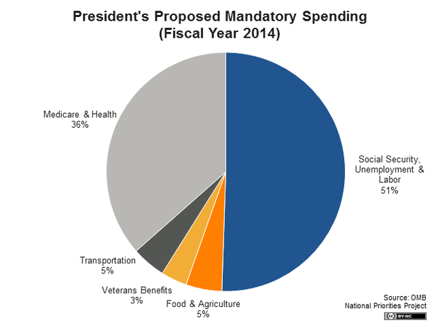

Slide 10
Let’s Look at our W2 and see where the money goes!

Slide 11
First Step: Using the list below, put in order of importance to you
Military
Food and Agriculture
Labor
Transportation
Science
Energy and Environment
International Affairs
Health
Housing and Community
Veterans Benefits
Government
Education

Slide 12
First Two: Assign a Percentage to each item on your list. It needs to add up to 100%
Military | 57%
Food and Agriculture | 1%
Labor | 2%
Transportation | 3%
Science | 3%
Energy and Environment | 3%
International Affairs | 3%
Health | 5%
Housing and Community | 5%
Veterans Benefits | 6%
Government | 6%
Education | 6%
Total | 100%

Slide 13
 | W2 BOX 2= | $2,707.00
 |  |  | Annual | Monthly | Daily
 | Military | 57% | $1,542.99 | $128.58 | $4.23
 | Food and Agriculture | 1% | $27.07 | $2.26 | $0.07
 | Labor | 2% | $54.14 | $4.51 | $0.15
 | Transportation | 3% | $81.21 | $6.77 | $0.22
 | Science | 3% | $81.21 | $6.77 | $0.22
 | Energy and Environment | 3% | $81.21 | $6.77 | $0.22
 | International Affairs | 3% | $81.21 | $6.77 | $0.22
 | Health | 5% | $135.35 | $11.28 | $0.37
 | Housing and Community | 5% | $135.35 | $11.28 | $0.37
 | Veterans Benefits | 6% | $162.42 | $13.54 | $0.44
 | Government | 6% | $162.42 | $13.54 | $0.44
 | Education | 6% | $162.42 | $13.54 | $0.44
 | Total | 100%

Slide 14
First Three: Calculate how much money YOU would spend in each section of the Federal Budget
Do you think that Taxes are too high, Too Low, or just right?

